Slide 1


Inductive Bias in Machine Learning: The Foundation of Intelligent Generalization
ITA0603 - Machine Learning
Presented by :
V.Madhulika(192312620)

Slide 2
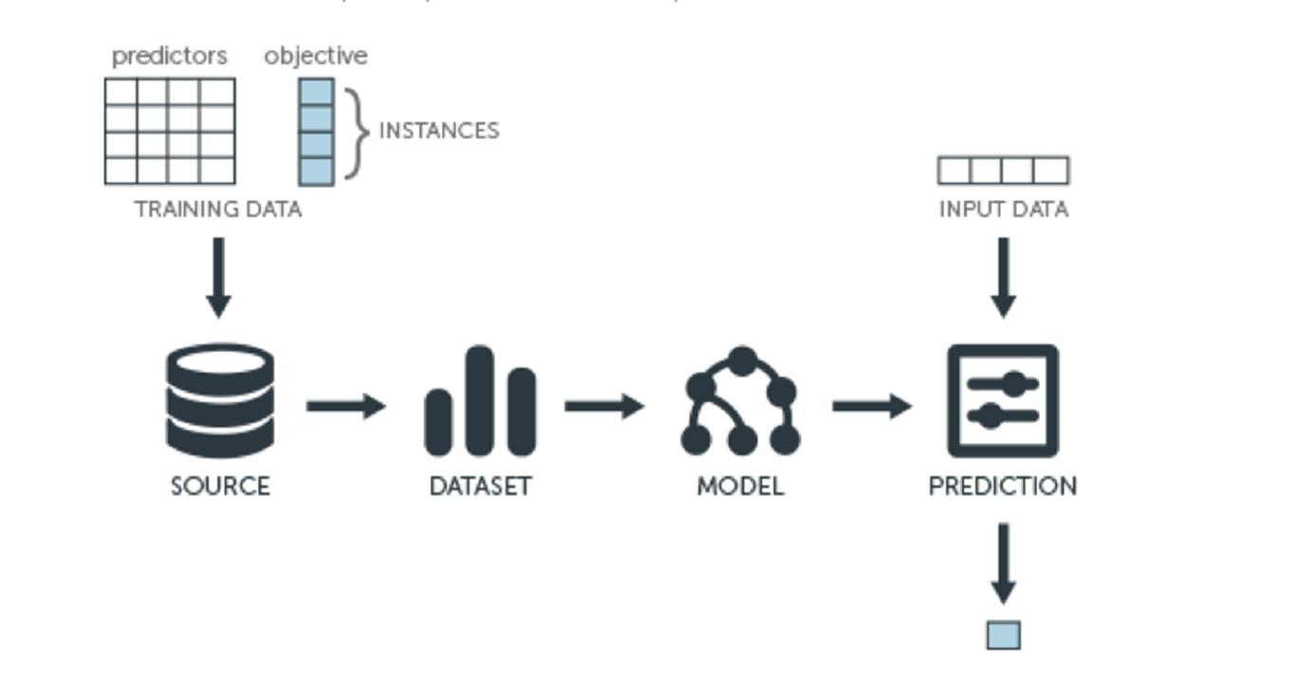
Introduction :
What is Inductive Bias?
Inductive bias is the set of assumptions a machine learning algorithm makes to predict unseen data.
It helps the model learn patterns from limited training data.
Without inductive bias, a model cannot generalize to new examples.
It is an essential concept in supervised learning

Slide 3
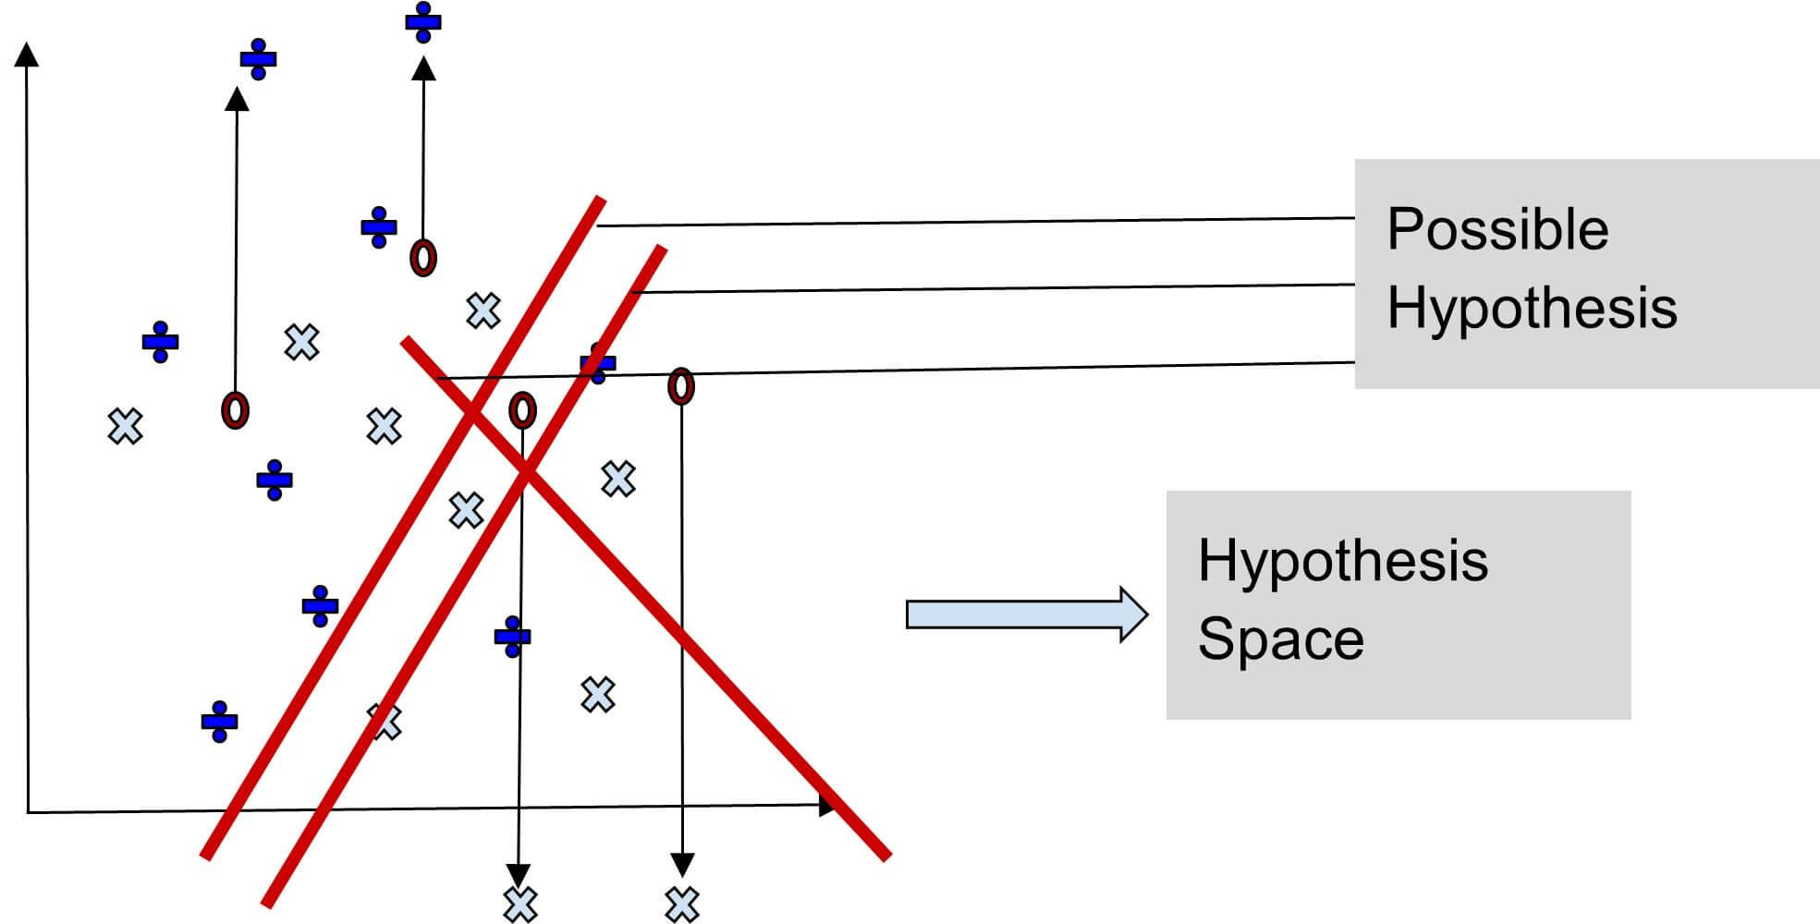
Types of Inductive Bias :
1. Restriction Bias
Limits the hypotheses the model can consider.
Example: Decision Trees allow only tree-structured rules.
2. Preference Bias
Allows many hypotheses but prefers simpler or more suitable ones.
Example: Choosing the smallest decision tree with the highest accuracy.

Slide 4
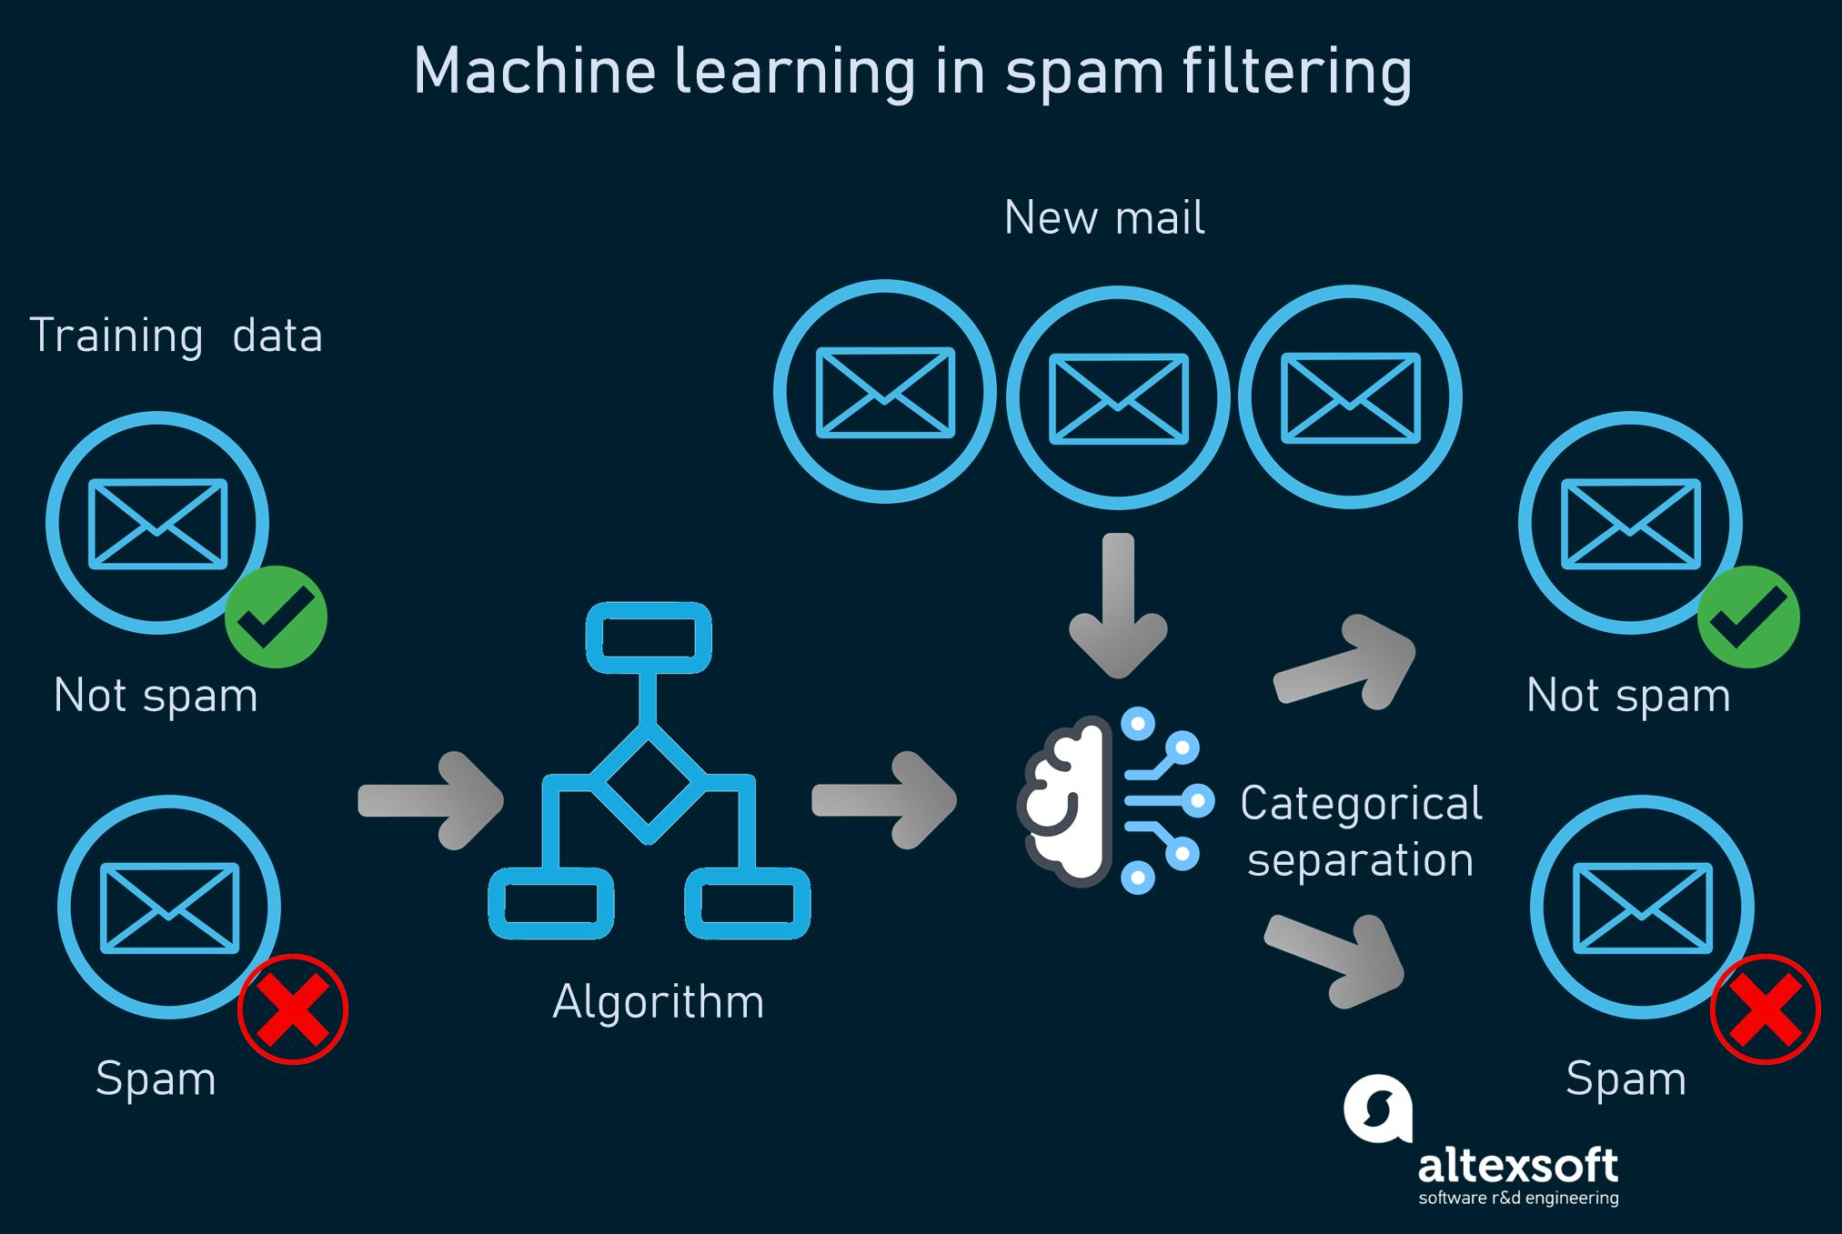
Importance of Inductive Bias
Why is it Important?
Enables prediction of unseen data.
Reduces overfitting.
Improves learning speed.
Produces better generalization.
Makes machine learning practical.
Example
Email Spam Detection
Training emails are labeled as Spam or Not Spam.
The model assumes similar future emails belong to the same class.

Slide 5
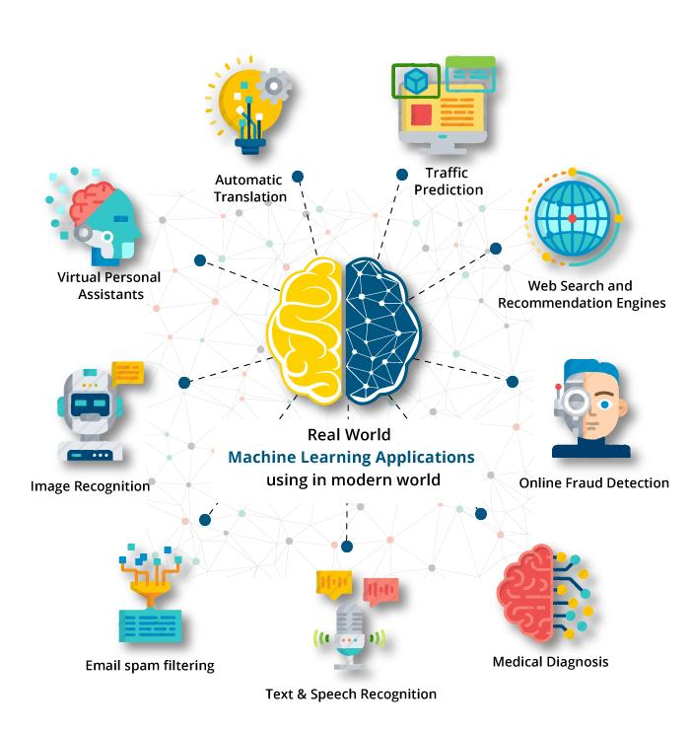
Applications and Challenges :
Applications :
Medical diagnosis
Image recognition
Speech recognition
Recommendation systems
Fraud detection
Challenges :
Poor-quality data
Wrong assumptions
Overfitting
Underfitting
Computational complexity

Slide 6
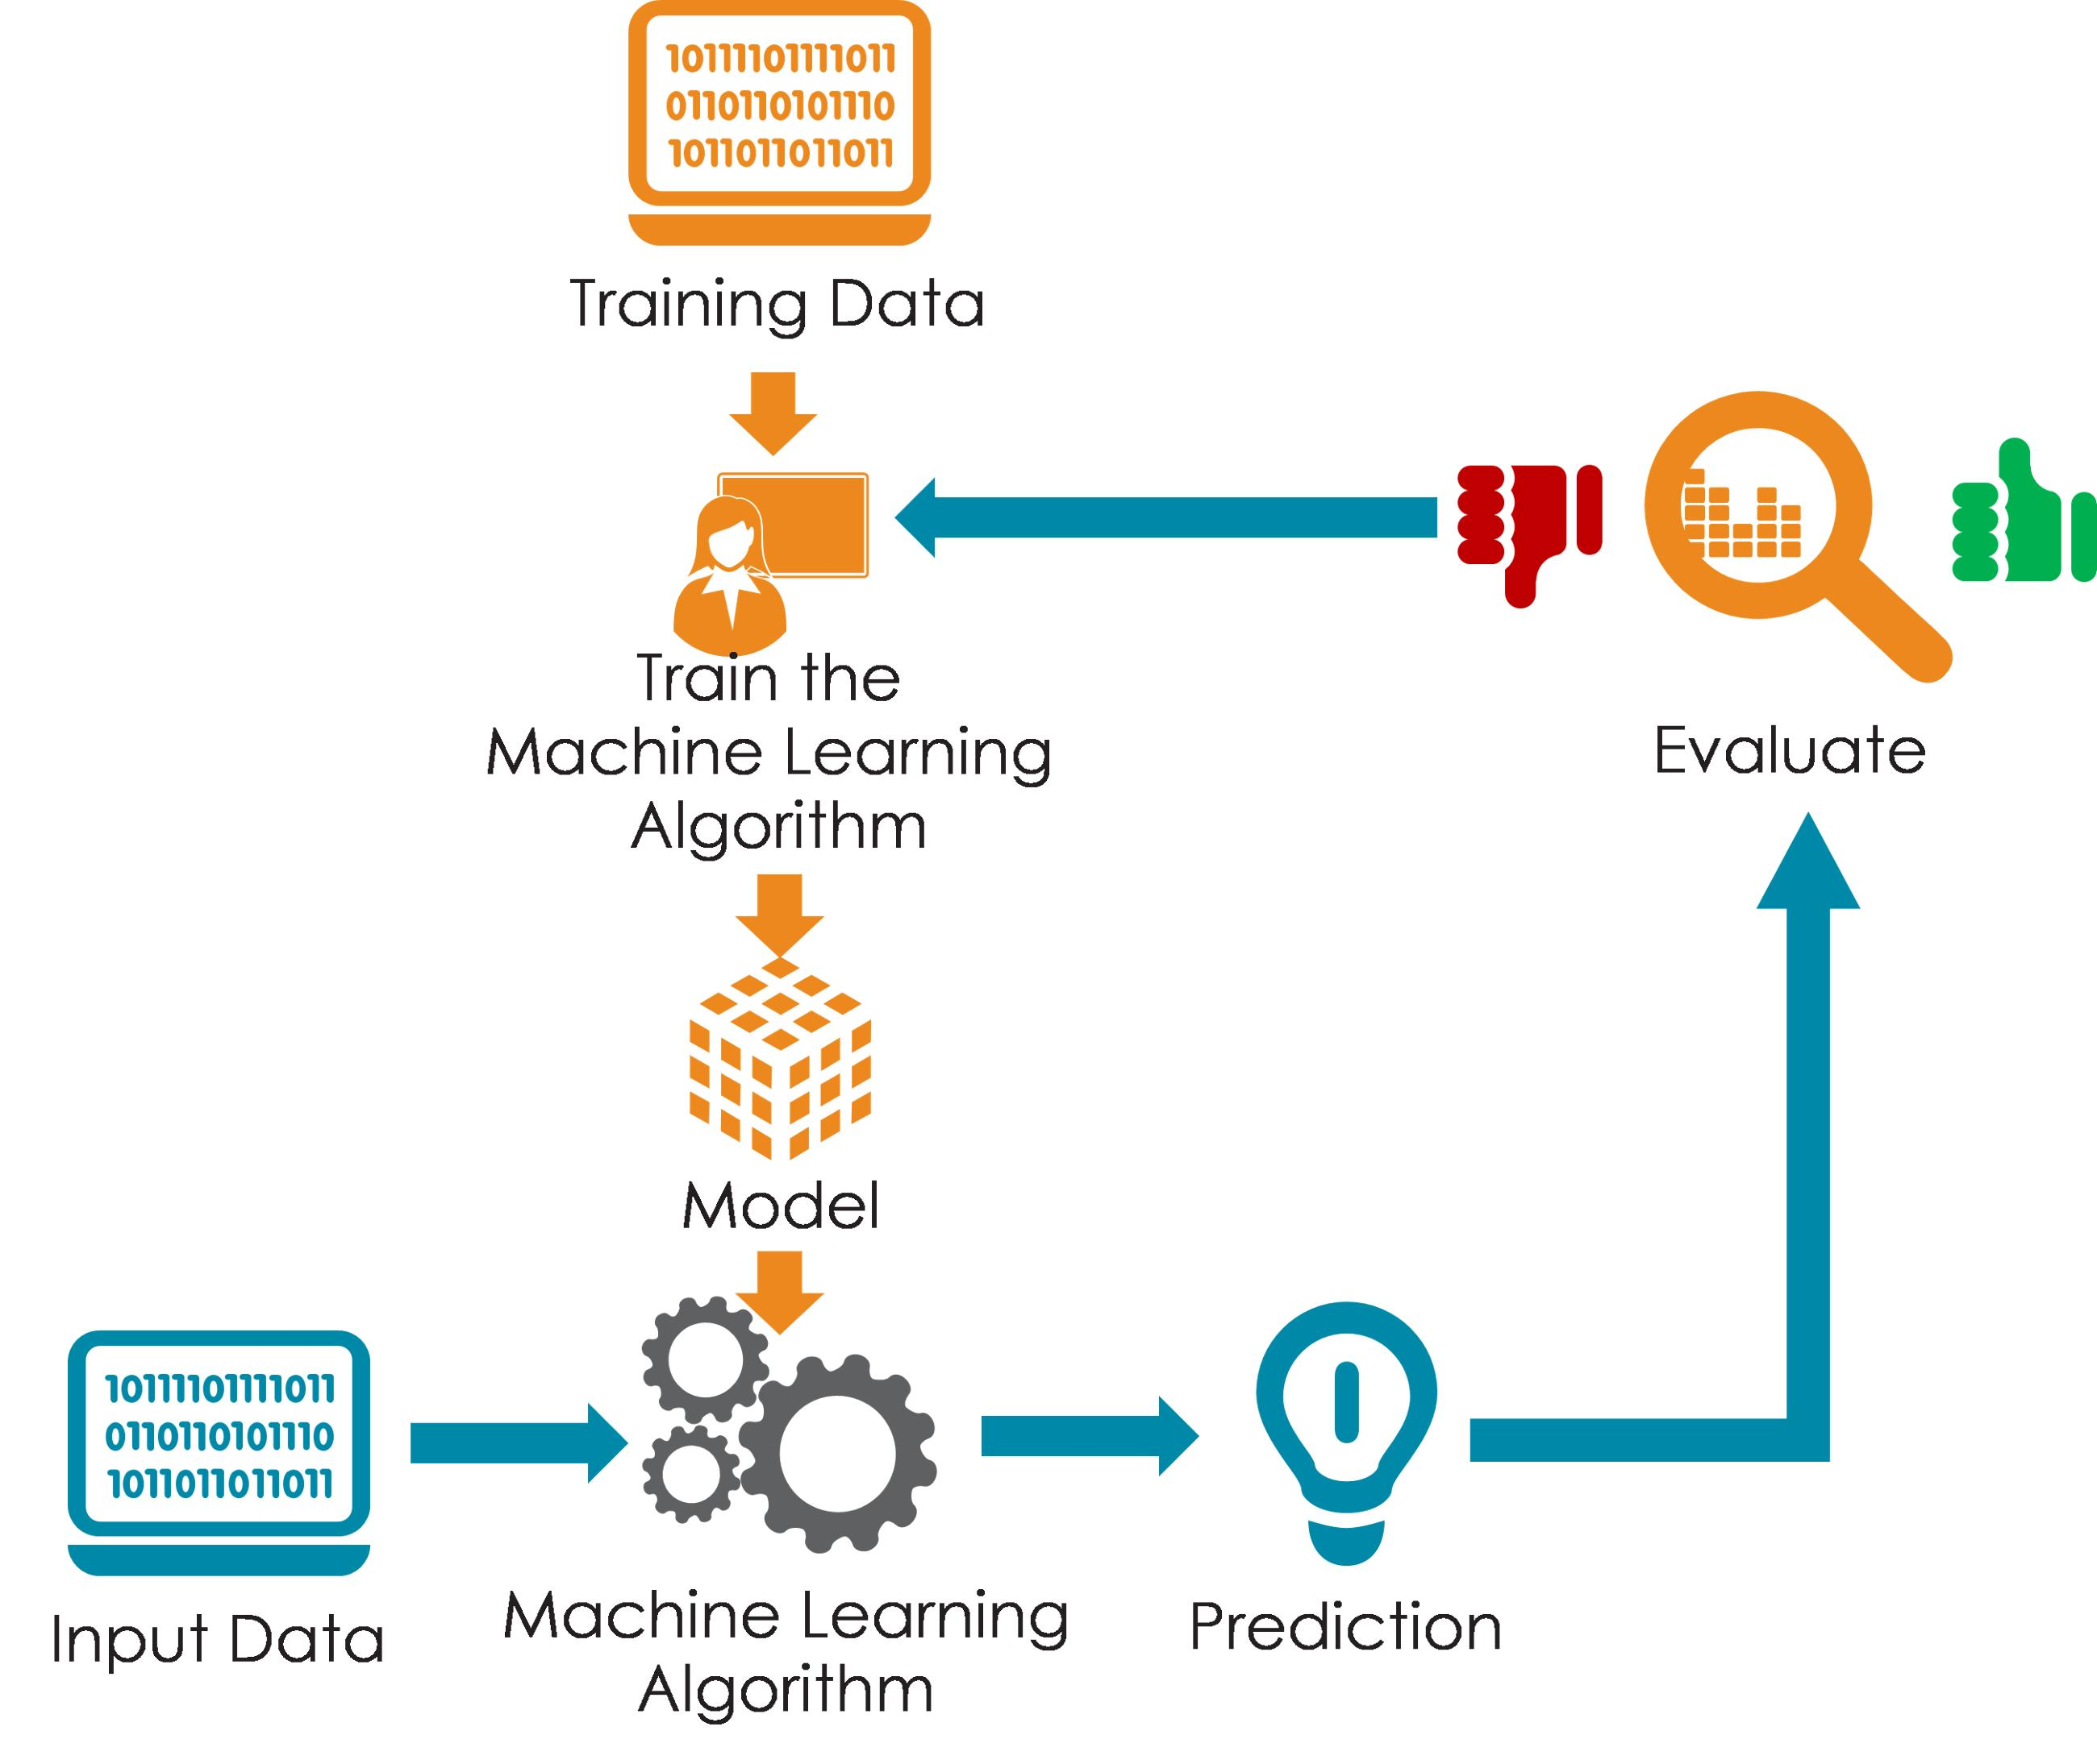
Conclusion :
Inductive bias is essential for machine learning.
It enables models to generalize beyond training data.
Restriction bias narrows the hypothesis space.
Preference bias selects the most suitable hypothesis.
Choosing the right bias improves accuracy and model performance.

Slide 7
Thank You

